Slide 1

Java course
-6-

Slide 2
3.WebApp and frontend

Slide 3

What is a frontend?
Front end is the visual part of a web application. It`s the part that is rendered on the client machine.

Slide 4
Front end types:
STATIC – pages that are sent to the client browser are of static nature and
are not modified during the execution of the webserver (plain HTML pages)
DYNAMIC – pages that have content which is modified based on the path
or variabiles that it gets(HTML with JS,JSP,etc)

Slide 5
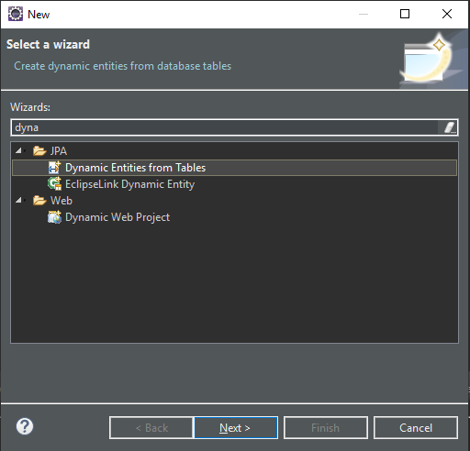
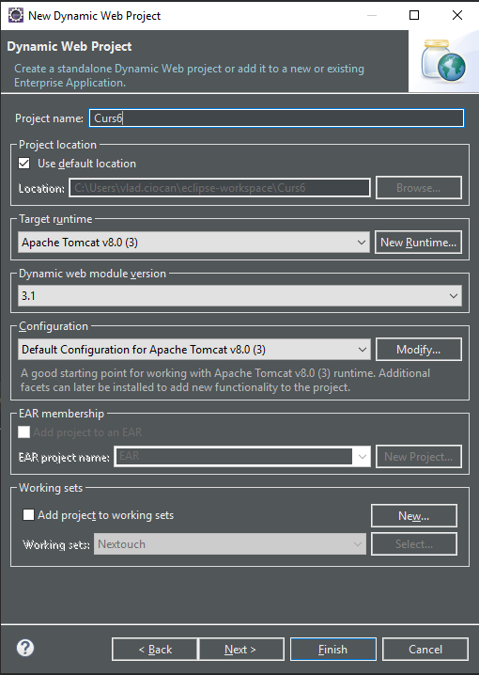
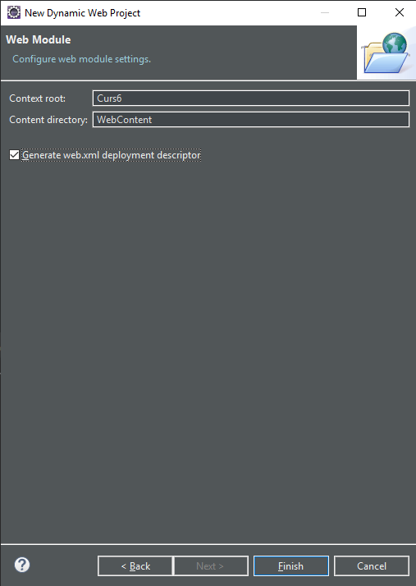
Lets get CODING ☺

Slide 6
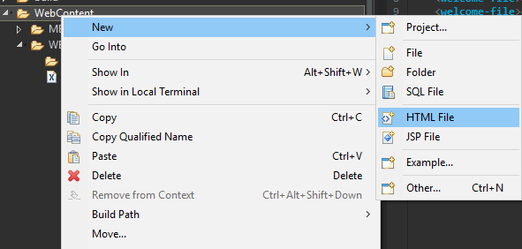
Adding frontend files to a webapp
First steps
After creating a new or using an existing project,open WebContent folder and create 2 HTML files and one JSP file

Slide 7
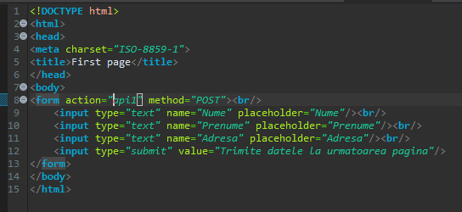
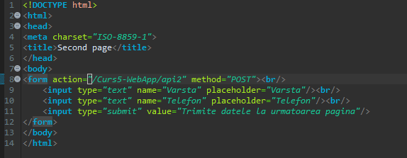
Write HTML Files

Slide 8
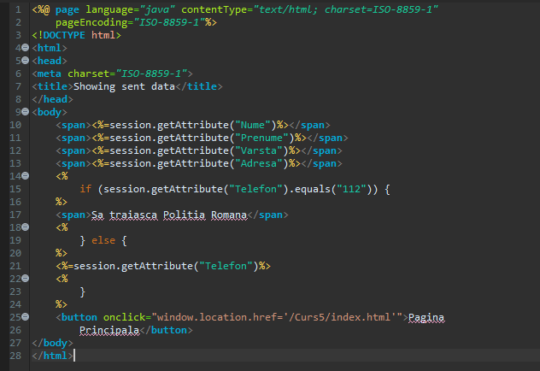
Write the JSP`s

Slide 9
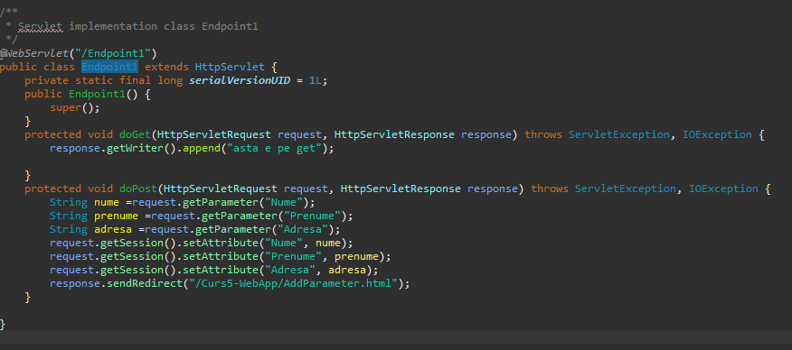
Write First servlet

Slide 10
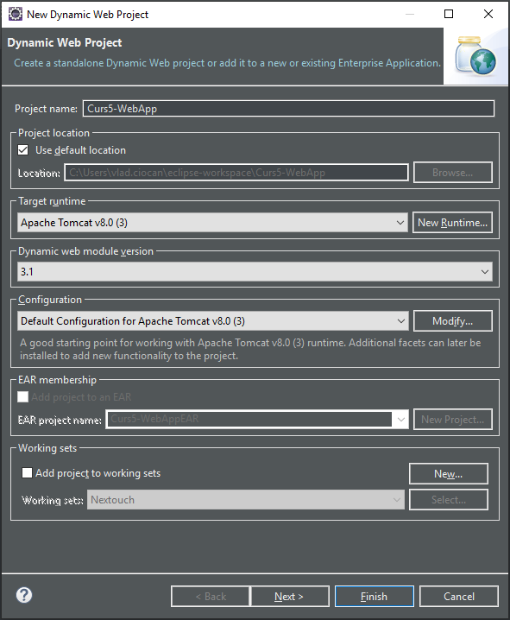
Creating a WebApp
Step 2: Fill form

Slide 11
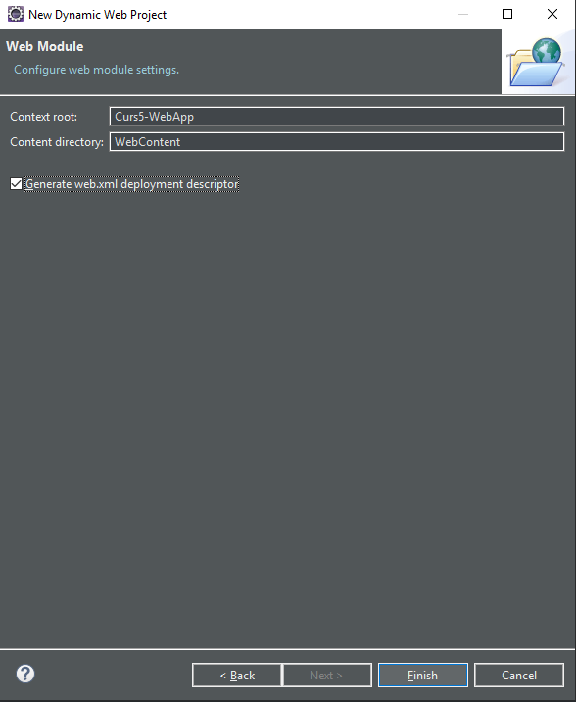
Creating a WebApp
Step 3: Check to generate web.xml

Slide 12
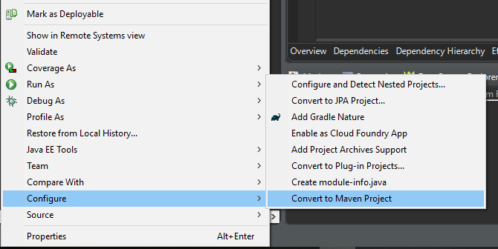
Creating a WebApp
Step 4: Convert to Maven Project

Slide 13
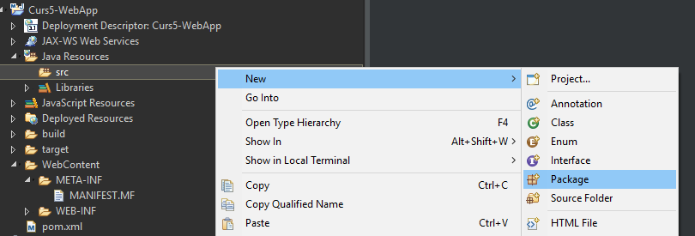
Creating a WebApp
Step 5: Add main Package
<servletContainer>

Slide 14
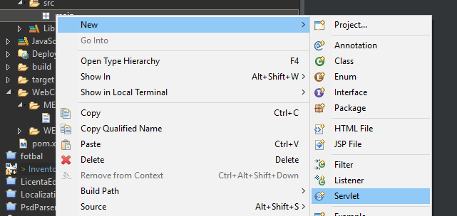
Creating a WebApp
Step 5: Add a servlet

Slide 15
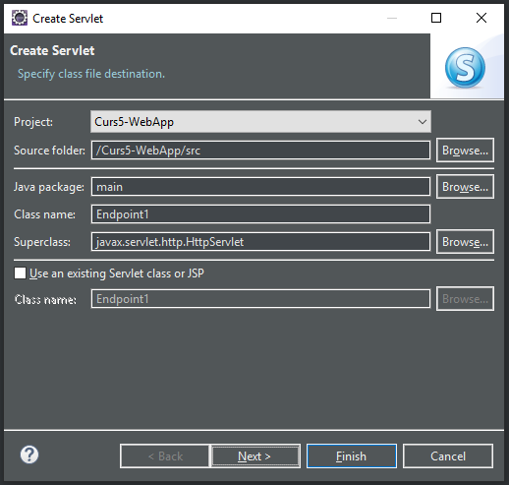
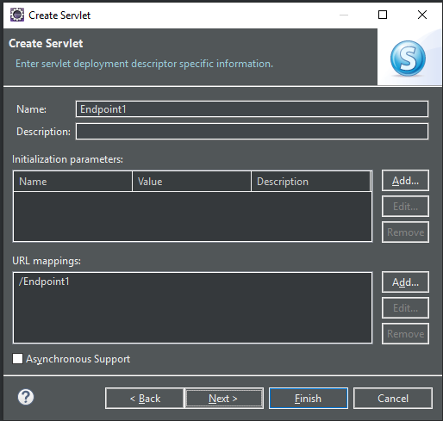
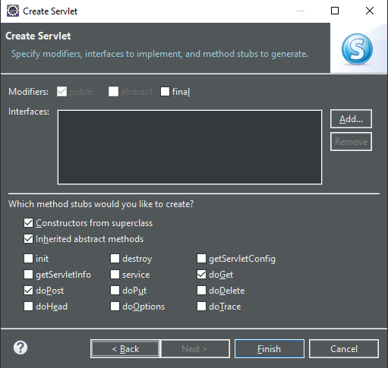
Creating a WebApp
Step 6: Configure servlet

Slide 16
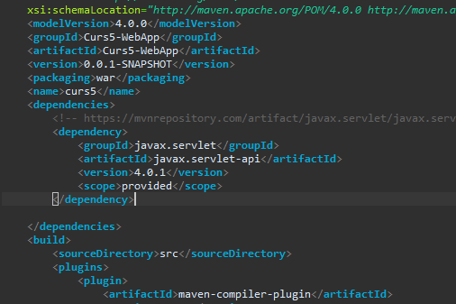
Creating a WebApp
Step 6: Add maven dependencies

Slide 17
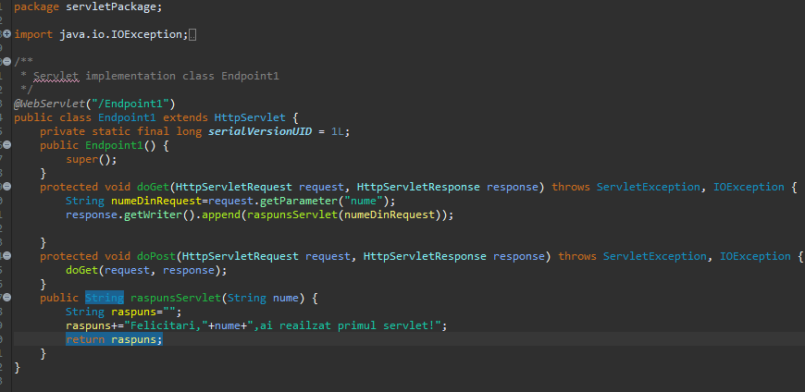
Creating a WebApp
Step 7: Add logic

Slide 18
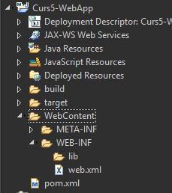
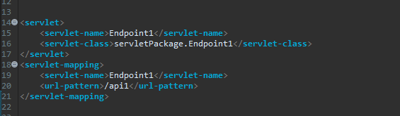
Creating a WebApp
Step 7: Map servlet in web.xml

Slide 19
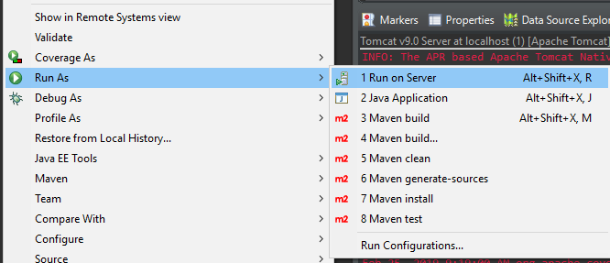
Creating a WebApp
Step 8: Save and run on server

Slide 20
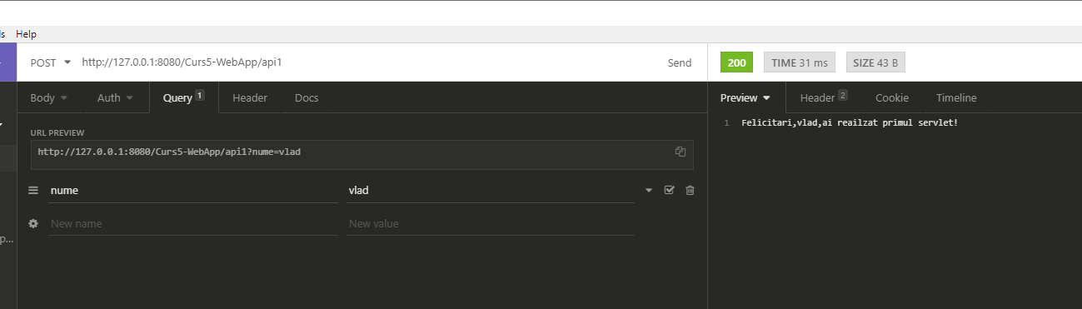
Test it

Slide 21
That`s it for today
Session review
-You learned servlets
-You learned about tomcat
-You know how API`s work
-You created you`re first endpoint
GOOD JOB! ☺

